Slide 1

ENME480 Lab Week 2 Field Trip!
Alex Beyer, Kaustubh Joshi

Slide 2
ENME480 Lab Week 2 Python/Ubuntu Crash Course
Alex Beyer, Kaustubh Joshi

Slide 3
Todays Plan
Software Installation & Setup
Software Intro (Ubuntu, Python, ROS)

Slide 4

Installing Ubuntu
Three ways (that we support):
Windows 10/11 – Use WSL2
Mac OSX – Use UTM Virtual Machine
Running Ubuntu natively
Spend the next 20-30 minutes installing everything – enme480.github.io

Slide 5
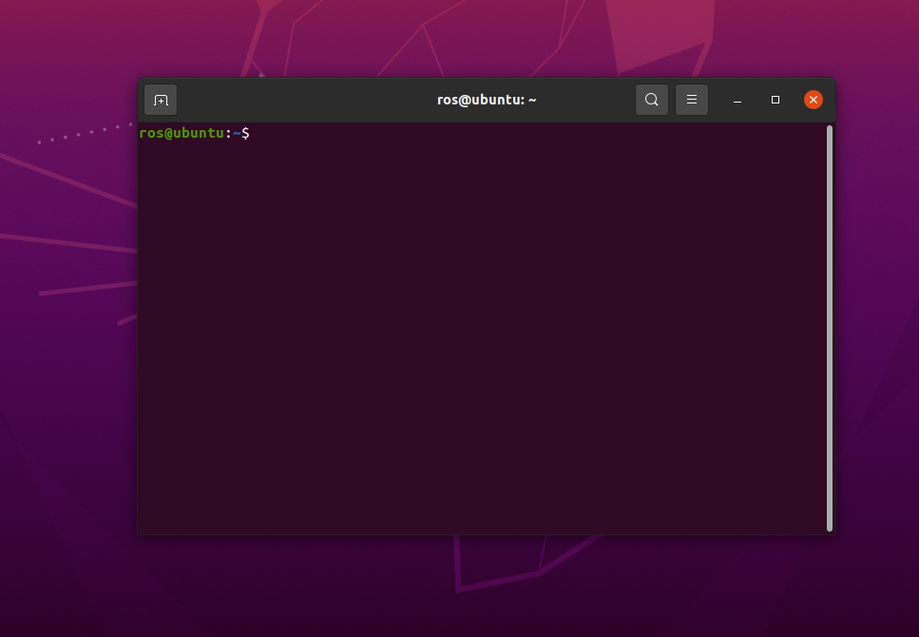
Ubuntu Basics – The Shell
Also called: Shell, Prompt, Bash, Terminal
Ubuntu relies on the shell more than Windows!
WSL only has the Ubuntu shell, no GUI
Open a terminal shortcut: Ctrl + Alt + T
Open a terminal in a new tab: Ctrl +Shift + T

Slide 6
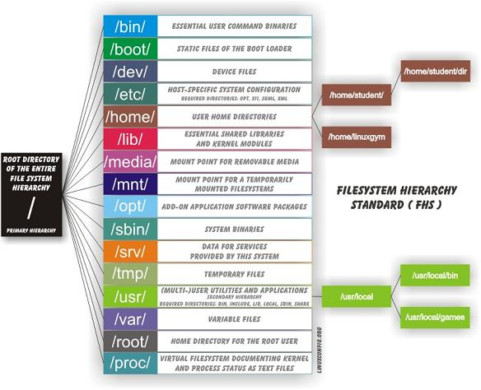
Ubuntu Basics - Terminal
Commands are case sensitive:
print working directory – pwd
change directory – cd dir
cd / %return to root directory
cd .. %step back one level
cd stuff1/… %from the current directory, enter the stuff1 folder
cd /stuff1/ %from the root directory, enter the stuff1 folder
clear the terminal - clear

Slide 7
Ubuntu Basics - Terminal
Commands are case sensitive:
make directory – mkdir dirname
mkdir folder1 – make folder1 in working dir
list files in working directory – ls
Concatenate (print) file – cat filename
cat file.txt – print file contents to terminal

Slide 8
Ubuntu Basics - Terminal
Commands are case sensitive:
move a file – mv filename destination
mv myfile.txt myfolder
copy a file – cp filename destination
remove a file – rm filename
remove a directory – rm dirname

Slide 9
Ubuntu Basics - Terminal
Commands have flags to change behavior:
Ex: ls -a
“ls” lists all files in a folder and “-a” means to list all files, including hidden ones (i.e. files whose name begins with a “.”)
User privilege doesn’t work the way it does on Windows/OSx
“super user do” (sudo) command
chmod 777 <filename> or chmod +x <filename>
“chmod” changes the permissions of a file
Type “man chmod” in terminal to show the help page

Slide 10
Ubuntu Basics - Packages
Ubuntu has a built in package manager for installing from shell
Test it yourself, try installing these two packages (one is for the homework):
sudo apt install tree
generates tree views of file structures
sudo apt install aptitude
custom package manager with good conflict resolution
Normally you can replace apt with aptitude to switch managers

Slide 11
Ubuntu Basics - GitHub
GitHub lets you manage and collaborate on programming projects with multiple people
sudo apt install git-all
git clone <source> - Download a repo
git pull – When in a repo, download the latest update
git add <files or –a> - Track local changes to files
git commit – Upload local changes to the project
git fork – Create a project branch you own and can edit

Slide 12
Deliverables
Ubuntu:
Using the commands from today, create a directory called “studio2” on your desktop, then:
Create three folders (folder1, folder2, folder3) w/in that directory
W/in folder1: create a folder 2 directory, then another folder3 directory w/in that
In this directory, make a text file and print its contents to the terminal
Deliverable I: filetree image (see next slide) and image of terminal printing file contents
Python:
Write a sieve of Eratosthenes (next 2 slides) and use it to find every prime up to 1000
Challenge: What is the fewest number of lines this can be done in?
Deliverables: .py file, screenshot of terminal output (in Ubuntu) containing primes up to 1000
Github:
Clone the MRC driver repo: github.com/MarylandRoboticsCenter/ENME480_mrc
Screenshot of the output of “git pull” or “git status” showing the ENME480 docker repo has been downloaded

Slide 13
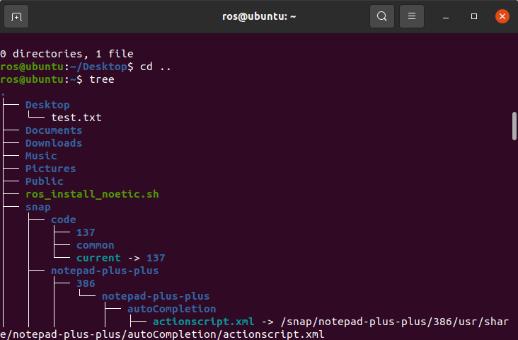
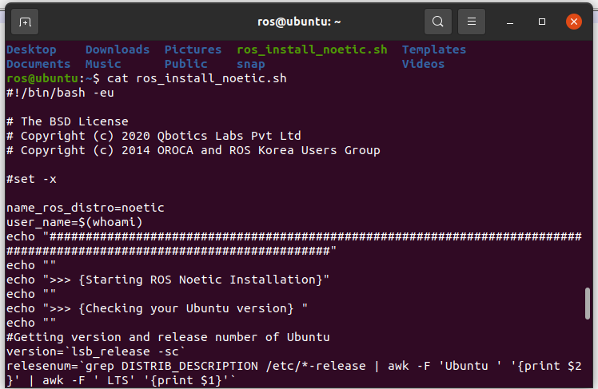
Deliverables
Example Tree view:
Example file readout:
Yours will be simpler!

Slide 14
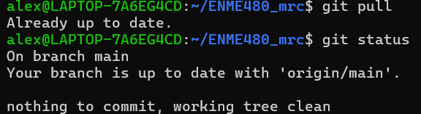
Deliverables
We are looking for a git output like:

Slide 15
Sieve of Eratosthenes
Sieve of Eratosthenes Steps:
Create a list of integers 2,…,n
Let p = 2
Remove any integer multiple of p less than n from the list
Set p as the next largest remaining number, if there is no next largest number, stop
Values remaining in the list are all the primes less than n
Hint: there are 168 primes < 1000

Slide 16
Why Ubuntu?
Ubuntu is a Linux based OS designed using primarily Free and Open Source Software (FOSS)
Nothing is closed to the user; its extremely customizable
Easy to mod
Runs on almost any hardware made in the last decade
Software support isn’t always great

Slide 17

Python Basics
Python is a free, open source, multi-paradigm language designed to be as useful as possible as much as possible
Advantages:
“Jack of all trades, master of none”
Huge library of packages with good community support
High level interpreted language; compiled at runtime and has a GC
Disadvantages:
“Jack of all trades, master of none”
Packages are maintained by the community

Slide 18
Python Syntax
Python and MATLAB both use == to check for equality and = for assignment
Ex: “x = 2” set x to 2, “x == 1” checks if x is set to 1
Python code is suppressed by default, no semicolons needed
Many formatting options, especially for print statements are the same between MATLAB and Python
MATLAB focuses on having a very large core library, Python focuses on having a much smaller core lib with good support for community libraries

Slide 19
Python Syntax
Python is weakly typed, don’t need to declare variable types:
x = 1 # this is an int
x = 1.0 # this is a float
x = “1” # this is a string

Slide 20
Python Syntax
Logic statements (if, for, while, etc.) are more or less the same as MATLAB
Python has significant whitespace! Two of the below codes break:
x = 1
if x == 1
x = x + 1
print(x)
end
x = 1
if x == 1
x = x + 1
print(x)
end
x = 1
if x == 1
x = x + 1
print(x)
end

Slide 21
Python Syntax
Python has significant whitespace! Two of the below codes break:
Note: Many Python IDEs have features to avoid exactly this problem
x = 1
if x == 1
x = x + 1
print(x)
end
x = 1
if x == 1
x = x + 1
print(x)
end
x = 1
if x == 1
x = x + 1
print(x)
end
This has the same indentation (one tab) on lines 3 and 4, it runs
Line 3 is only indented 3 spaces while line 4 is indented 4 spaces
Line 3 has 4 spaces, line 4 has one (4 space wide) tab – they don’t mix

Slide 22
Python Syntax
If you’re coming from MATLAB you’re used to start:step:stop
Matrix slicing follows the pattern:
start:stop:step
No support for MATLAB style usage of “end” as an index, instead you use “-1” for the last element, “-2” for the 2nd to last, etc.
Many packages (including numpy, which we use) will introduce new syntax or define special types of matrices with different rules!

Slide 23
Python Syntax
Because this may matter for your homework, Python functions look like this:
Notice:
Outputs are only output when passed via return
There is no end statement, unindenting the code is how you break out
def functionName(args):
# properly indented code goes here
return vars
# Unindented code, outside the function

Slide 24
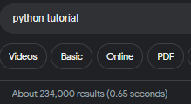
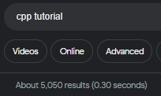
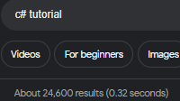
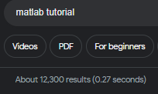
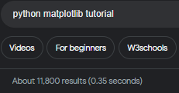
Python
Python has an incredible amount of community support – search any issues/questions you have and chances are someone else has had (and solved) it

